Slide 1
Git’n Pro with HTML/CSS

Slide 2

It’s Okay!
How do I do this again?
Flickr: welcometolearn

Slide 3
Admin Items

Slide 4
Where to Get Help
Practice, Practice, Practice: Work Individually or in Groups
Review In Class Material (Exercises and Slides): https://gw.bootcampcontent.com/GW-Coding-Boot-Camp/GWAR201810FSF3/tree/master/01-Week/01-Day-Activities https://gw.bootcampcontent.com/GW-Coding-Boot-Camp/GWAR201810FSF3/blob/master/01-Week/Slides/GW_T1.pdf
Re-Watch Class Videos: https://www.bootcampspot.com/sessions/471444/videos/27711
In Class Office Hours: 45 minutes before class, 30 minutes after
One-on-One Sessions: By Announcement through SSM
Contact Student Success: Anytime!

Slide 5
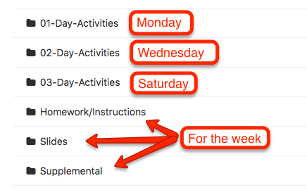
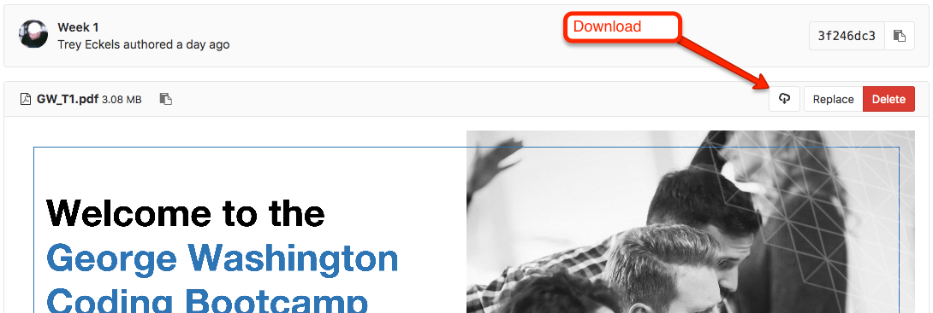
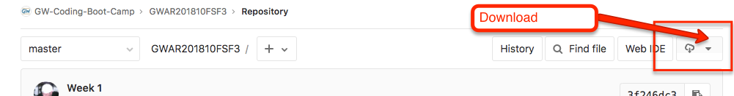
GitLab
Also, at this point everyone should have access to the class content and homework repository in GitLab. https://gw.bootcampcontent.com/GW-Coding-Boot-Camp/GWAR201810FSF3/tree/master

Slide 6
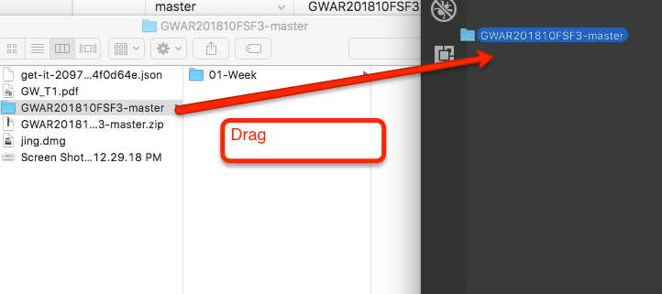
GitLab 2 - Dragging Folders Into VSCode
You can drag folders into VSCode

Slide 7
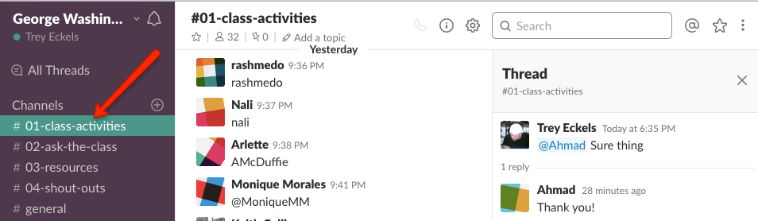
Slack
Also, at this point everyone should have access to Slack

Slide 8
Today’s Class!

Slide 9
Today’s Objectives
Students will review using the command line.
Students will create their first HTML page.
Students will understand the importance of Git Version Control and of how to use it.
Students will create GitHub Repositories, push code into them, and share with class.
Students will make more HTML documents.
Students will learn to properly use basic HTML tags.
Students will implement basic CSS styling to HTML documents.

Slide 10
Bash / Terminal Commands Recap
Instructions
From the Terminal/Console and using only the command line, create the following:
A new folder with the name of second_day_stuff
A new HTML file with the name of first-day.html
Open the current folder containing the new HTML file.

Slide 11
Know Thyself
If you are a complete beginner to HTML/CSS and Coding:
Continue getting comfortable with HTML.
Be able to completely write a basic HTML document (like in last class).
Understand what CSS is, what it’s for, and how it works with HTML.
Be able to use Git and GitHub to upload code.
If you’ve had past exposure and felt comfortable with the last lesson:
Aim to build up your skills. Clear up any questions or confusions about HTML.
Become knowledgeable about a wider range of HTML and CSS tags.
Be able to selectively apply CSS to specific HTML elements.
Be able to use Git and GitHub to upload code.

Slide 12
Hello, HTML
Notes:
Now that you can create HTML files from the terminal, let’s create one and actually write some HTML.

Slide 13

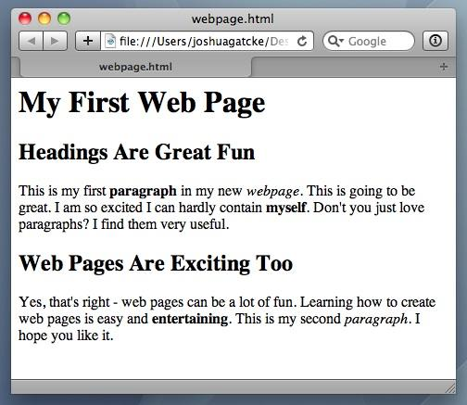
<title> Intro to HTML </title>
HTML is one of the three base languages behind every single website.
It defines all of the basic content and a bit of formatting.

Slide 14
> OUR TURN
Assignment:
In a new HTML file, create the basic structure of an HTML document and include the following in it:
DOCTYPE declaration.
Head tag with a title tag.
H1 tag with a title of your choice.
Embed an image.
Create the following three links on your page:
One link that has target="_blank" which opens a new tab when clicked
Make the second link bold.
Make the third link a placeholder so it goes nowhere.
Bonus:
Create an ordered list of steps to make a sandwich.
Create an unordered list of 5 bands/musicians you like.
Create a table with 2 columns (animal class and animal name) and 4 rows of animals.
Use an alternate way of separating links without line breaks.
Embed a YouTube video of your favorite band/musician.

Slide 15

YouTube Video Walkthrough!
https://www.youtube.com/watch?v=ieb6Svbc10E&index=1&list=PLgJ8UgkiorCnMLsUevoQRxH8t9bt7ne14

Slide 16
<title> Intro to HTML </title>
How’d it go?

Slide 17
What / Why Git?

Slide 18
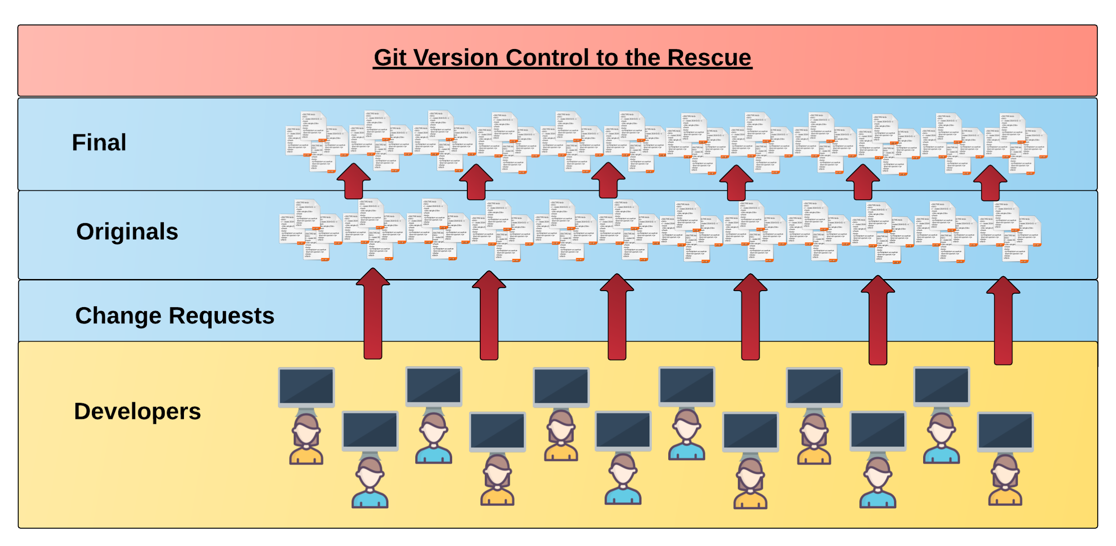
Collaborative Coding
Modern web development is highly collaborative.
Teams are often extremely large and separated across the country — or planet.
Apps sometimes comprise hundreds or even thousands of files.

Slide 19
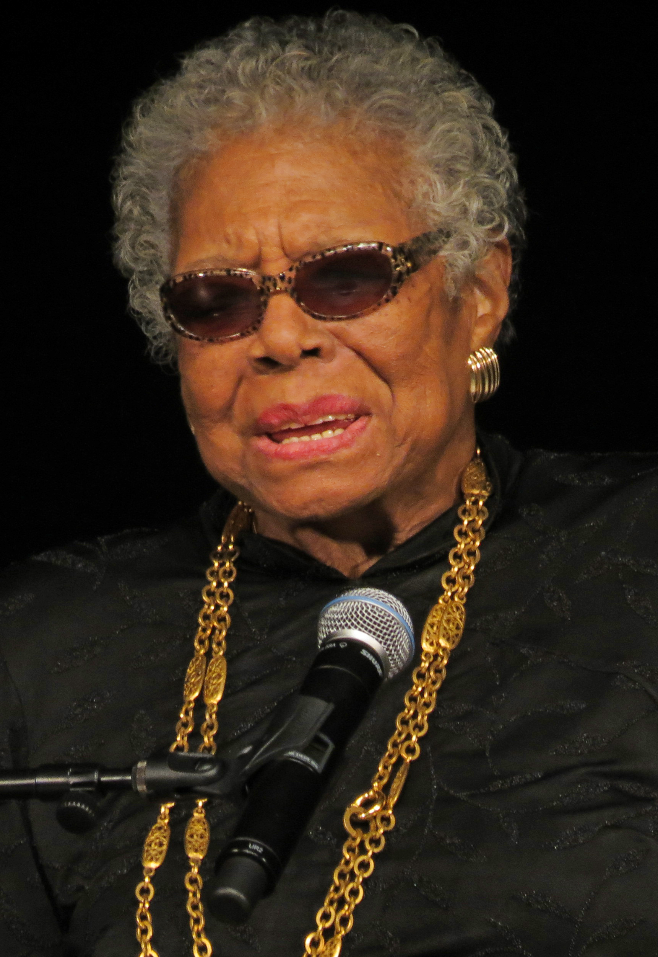
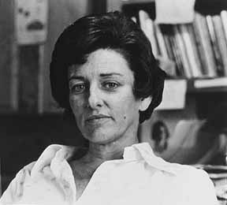

The Team’s Task
Task: Make a list of creative works you’ve written in the past
Programming Team:
Maya Angelou
Anne Sexton
Gil Scott Heron

Slide 20

Maya & Gil make their edits
Programming Away…
Maya’s Version
Programming Away…
Gil’s Version

Slide 21
Different Solutions
<ul>
<li>On the Pulse of Morning</li> <li>I Know Why the Caged Bird Sings</li> <li>And Still I Rise</li>
</ul>
Different
<ul>
<li>Free Will</li> <li>Pieces of a Man</li> <li>The Revolution will not be Televised</li>
</ul>

Slide 22
Resolution
<ul>
<li>On the Pulse of Morning</li> <li>I Know Why the Caged Bird Sings</li> <li>And Still I Rise</li>
</ul>
“Let’s settle on this…”
<ul>
<li>Poems</li> <li>Albums</li> <li>Songs</li>
</ul>
<ul>
<li>Free Will</li> <li>Pieces of a Man</li> <li>The Revolution will not be Televised</li>
</ul>

Slide 23
Anne writes her own stuff…
<ul>
<li>The Double Image</li> <li>Heart’s Needle</li> <li>Baby Picture</li>
</ul>

Slide 24
Anne overwrites work of her teammates…
Delete. Delete. Delete. Delete.
Delete. Delete
<ul>
<li>Poems</li> <li>Albums</li> <li>Songs</li>
</ul>
<ul>
<li>The Double Image</li> <li>45 Mercy Street</li> <li>The Road Back</li>
</ul>

Slide 25
The Group Project
Lesson:
You should use Version Control.
….and watch your teammates’ work
Today we fret and pull on wheels, ignore our regular loss of time…
…or maybe we should just use git

Slide 26
Version Control
Git Version Control: Provides a organized system for managing code for when multiple developers work on a project
at the same time.
The Benefits of Git:
A process for resolving conflicts in code.
Version History.

Slide 27
The Group Project
Master Branch
‘Branch’ = personal copy
Personal branch
Maya’s branch
Anne’s branch
Gil’s branch

Slide 28
The team goes to work
<ul>
<li>On the Pulse of Morning</li> <li>I Know Why the Caged Bird Sings</li> <li>And Still I Rise</li>
</ul>
<ul>
<li>Free Will</li> <li>Pieces of a Man</li> <li>The Revolution will not be Televised</li>
</ul>

Slide 29
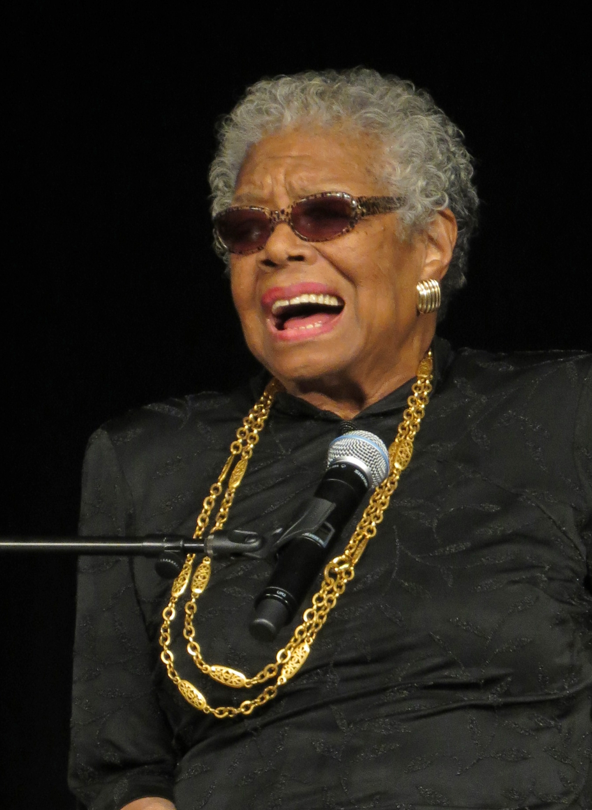
Maya pushes first
Master Copy
1
Maya pushes (uploads) her code changes into the main branch.
No code conflicts.
Maya’s Branch

Slide 30
Gil’s edits are ready
Rule: pull first, then push your changes
Ok

Slide 31
Gil pulls latest changes
Master Copy
1
Gil’s Branch

Slide 32
Gil conflicts with master branch
Master Branch
1
<li>On the Pulse of Morning</li> <li>I Know Why the Caged Bird Sings</li> <li>And Still I Rise</li>
<li>On the Pulse of Morning</li> <li>I Know Why the Caged Bird Sings</li> <li>And Still I Rise</li>
Git sees a conflict.

Slide 33
Kobe resolves
<ul>
<li>Poems</li> <li>Albums</li> <li>Songs</li>
</ul>
<li>On the Pulse of Morning</li> <li>I Know Why the Caged Bird Sings</li> <li>And Still I Rise</li>
<li>On the Pulse of Morning</li> <li>I Know Why the Caged Bird Sings</li> <li>And Still I Rise</li>
Gil’s Branch

Slide 34
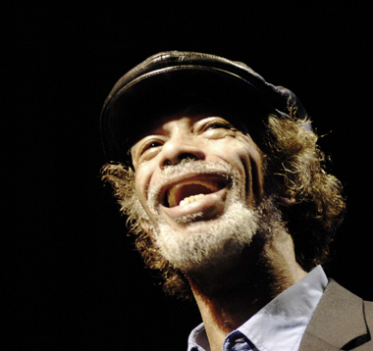
Gil fixes and pushes
Master Branch
1
2
Gil pushes (uploads) his revision the main branch.
No code conflicts.
<ul>
<li>Poems</li> <li>Albums</li> <li>Songs</li>
</ul>
Gil’s Branch

Slide 35
Anne starts her work
Rule: pull first, then push your changes
look into my face and you will know that crimes dropped upon me
as from a high building…
…by which I mean, I broke the rules.

Slide 36
Anne pushes
Master Branch
1
2
3
Anne dude pushes (uploads) her revision the main branch. No code conflicts.
Not what we want.
<ul>
<li>The Double Image</li> <li>Heart’s Needle</li> <li>Baby Picture</li>
</ul>
Anne’s Branch

Slide 37
If Annehad made a pull first…
Conflict!
<ul>
<li>The Double Image</li> <li>Heart’s Needle</li> <li>Baby Picture</li>
</ul>
<ul>
<li>Poems</li> <li>Albums</li> <li>Songs</li>
</ul>

Slide 38
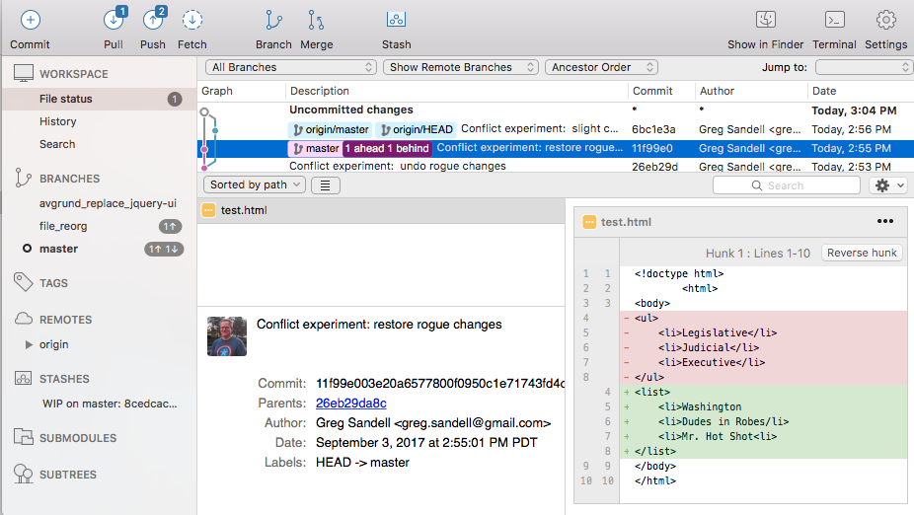
The overwritten work is discovered

Slide 39
Roll Back
Main Branch
1
2
3
4
Maya rolls back the code to an earlier version.
Anne’s Branch

Slide 40
The Group Project
Lesson:
You should use Version Control!

Slide 41
Quick Activity!
Suggested Time: 3 min
Turn to your neighbor, and have one of you explain to the other:
The concept of version control.
Then the other should explain:
Two of the key advantages to using a version control system.

Slide 42

So… What’s this GitHub?
GitHub is a Web-Based hosting service to store code online.
It allows developers to pull (download) code or push (upload) code to the same repository (directory).
It also allows developers to view histories of code changes and to track issues.

Slide 43

Pushing and Pulling to GitHub
1
2
3
4
GitHub Branch
Pull Code
Push Code
Pull Code
Pull Code
Push Code
Pull Code
Push Code

Slide 44
Get Started with Git

Slide 45
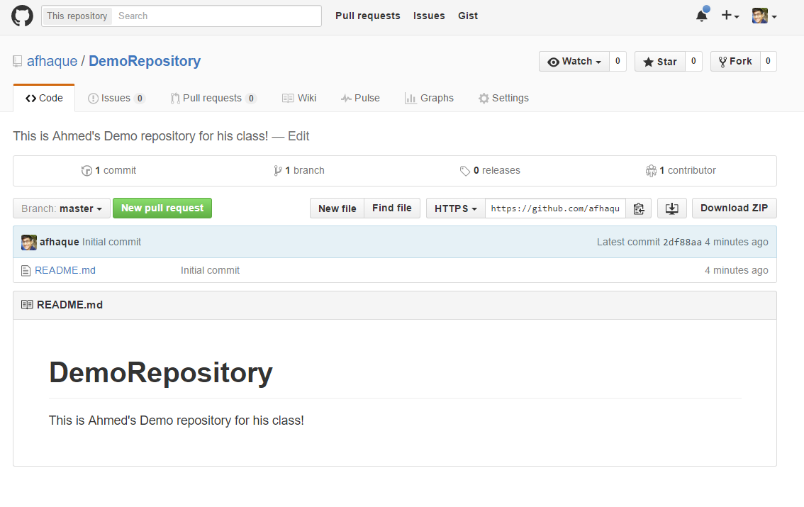
Instructor Git Demo!

Slide 46
Basic Git Commands
At its most basic, these are the five git commands to get started:
git clone
git add
git commit
git push
git pull

Slide 47
Basic Git Commands
At its most basic, these are the five git commands to get started:
git clone – copies an entire repo (to begin).
git add – adds a file for inclusion in Git.
git commit – notes a change to the local repo.
git push – sends changes to hosting service.
git pull – downloads freshest version of repo.

Slide 48
> YOUR TURN!
Activity: Git Add, Commit, Push | Suggested Time: 20 min
Assignment:
Using GitHub and the Command Line:
Create a new public GitHub repository and name it whatever you like. Be sure to check the box for “initialize this repository with a README.”
Next, clone the repo to your local directory.
Then create an HTML file inside the local directory.
Add, Commit, and Push the code to GitHub.
Bonus:
Find a partner in class, and fork their repository to your own GitHub account. Clone this forked repository to your local directory.
Add, Commit, and Push the code back to your forked copy.
Finally, submit a pull request to send your changes to your partner’s repo.

Slide 49

Still a Bit Lost? Never Worry!
Follow this handy Guide!
Practice a few times on your own before our next class.

Slide 50
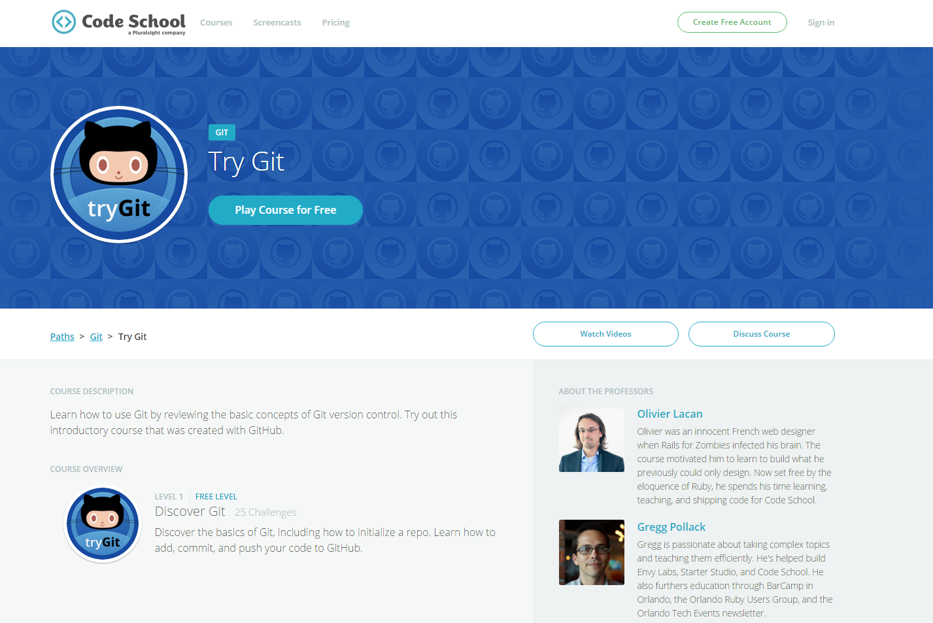
If You’re Still Lost… Here’s a (Free) Course
https://www.codeschool.com/courses/try-git

Slide 51
HTML Round 2

Slide 52
HTML Syntax (Basic)
Content
<h1>
This is Mah House
</h1>
Opening Tag
Closing Tag

Slide 53
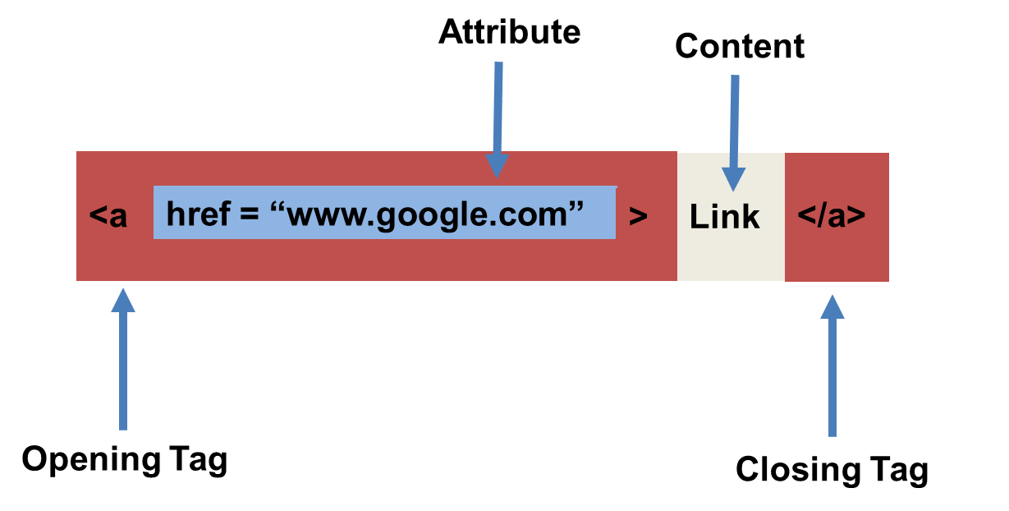
HTML Syntax (with Attribute)

Slide 54
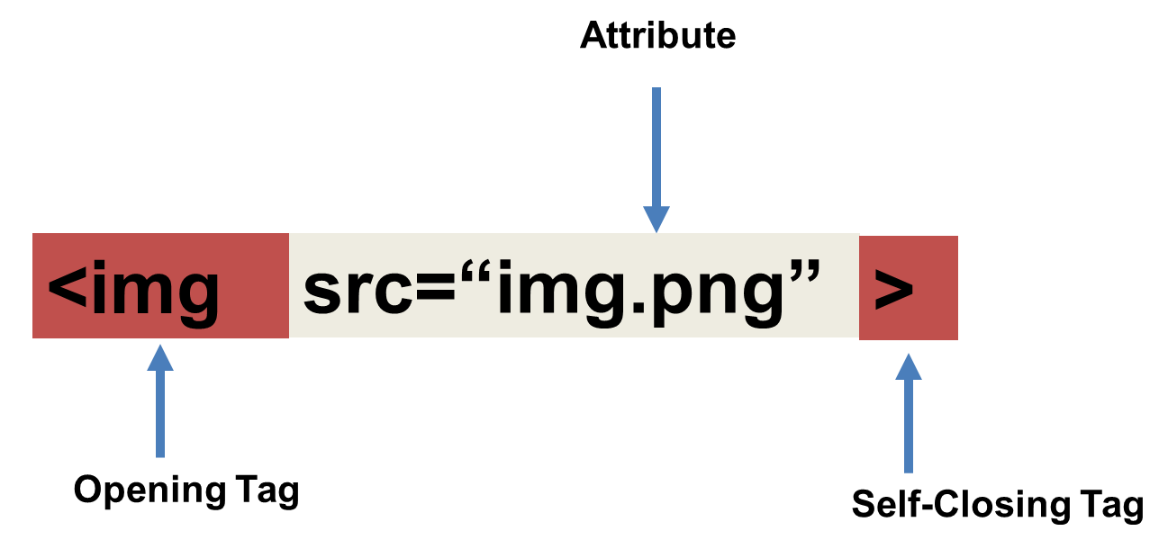
Tricky Tags (Self-Closing)

Slide 55
Important Common Tags
Headings:
<h1> </h1> - Heading 1 (Largest Heading)
<h2> </h2> - Heading 2 (Next Largest Heading)
<h3> </h3> - Heading 3
…
Containers:
<html> </html> - Wraps the entire page
<head> </head> - Wraps the header of the page
<body> </body> - Wraps the main content
<div> </div> - Logical Container ***
<p> </p> - Wraps individual Paragraphs
Others:
<strong> (bold), <em> (emphasis)
<img> (images), <a href> (links), <li> (list items) , <title> (title), <br> (line break), <table> (tables), <!-- --> (comments)

Slide 56
Less Common Tags
All HTML Tags are listed here: http://www.w3schools.com/tags/
Don’t try to memorize them! Simply refer back to documentation as needed.
Other tags:
<video> for Videos
<audio> for Audio files
<embed> for Embedded files
<code> for including computer code
<header> for headers
<nav> for navigation bars
<footer> for footers

Slide 57
HTML for Forms
Common UI (User Interface) Form Elements:
<form> - Creates a form section in HTML
<input> - Input boxes
<label> - Labels for boxes
<button> - Button
<textarea> - Large textbox

Slide 58
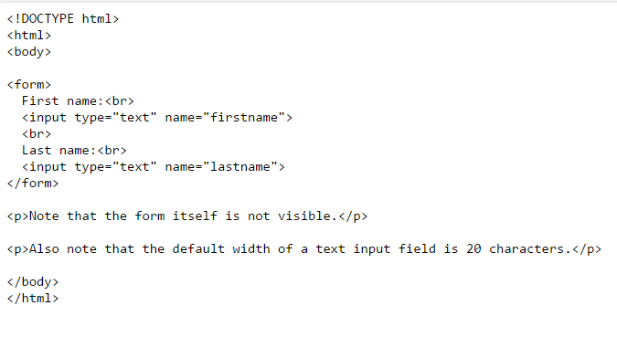
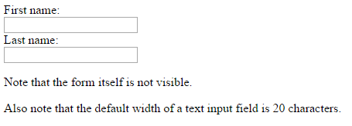
HTML for Forms

Slide 59
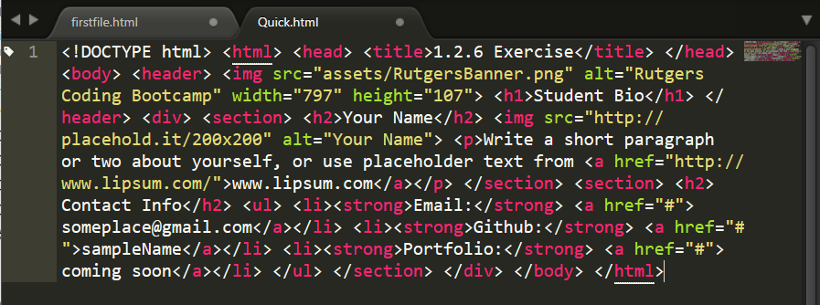
On Ugly HTML
Don’t do this… Use proper indentation and sectioning.
Readable code is easier to maintain.
Invest time to get better about this now. It will pay dividends!

Slide 60
> YOUR TURN!
Activity: 1-HTML_Git | Suggested Time: 20 min
Assignment
In this activity, you’ll create a student bio using HTML. You will then add, commit, and push your completed HTML to GitHub for the world to see.
Additional instructions, sent via Slack.

Slide 61
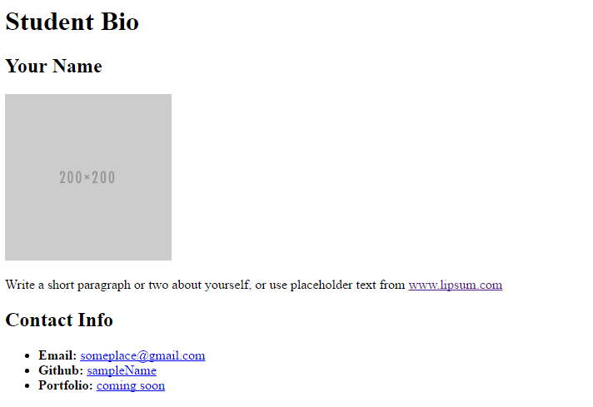
> YOUR TURN!

Slide 62
CSS Stylin’

Slide 63


HTML / CSS Definitions (*yawn* unimportant)
HTML: Hypertext Markup Language – (Content)
CSS: Cascading Style Sheets – (Appearance)
HTML/CSS are the “languages of the web.” Together they define both the content and the aesthetics of a webpage – handling everything from the layouts, colors, fonts and content placement. (JavaScript is the third – handling logic, animation, etc.)

Slide 64


HTML / CSS Analogy
HTML Alone
Like writing papers in “Notepad.”
Can only write unformatted text.
HTML / CSS
Like writing papers in Microsoft Word.
Can format text, page settings, alignment, etc. based on “highlighting” and menu options.

Slide 65
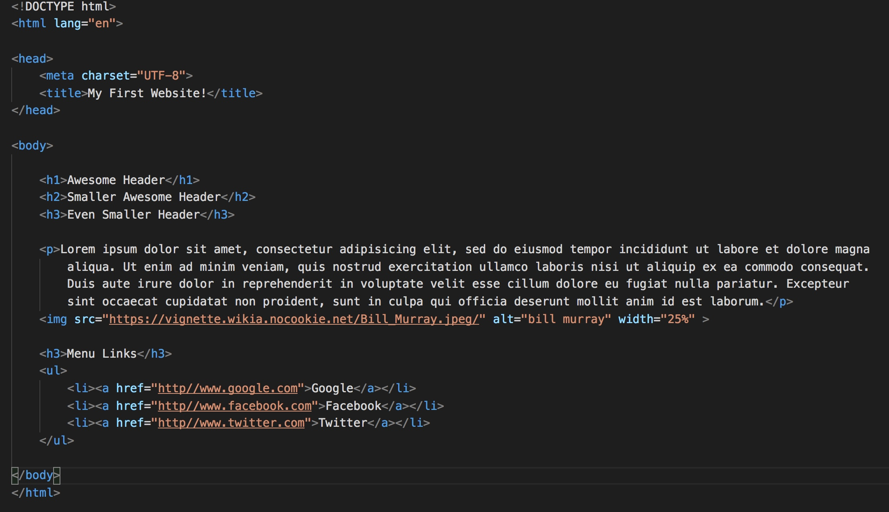
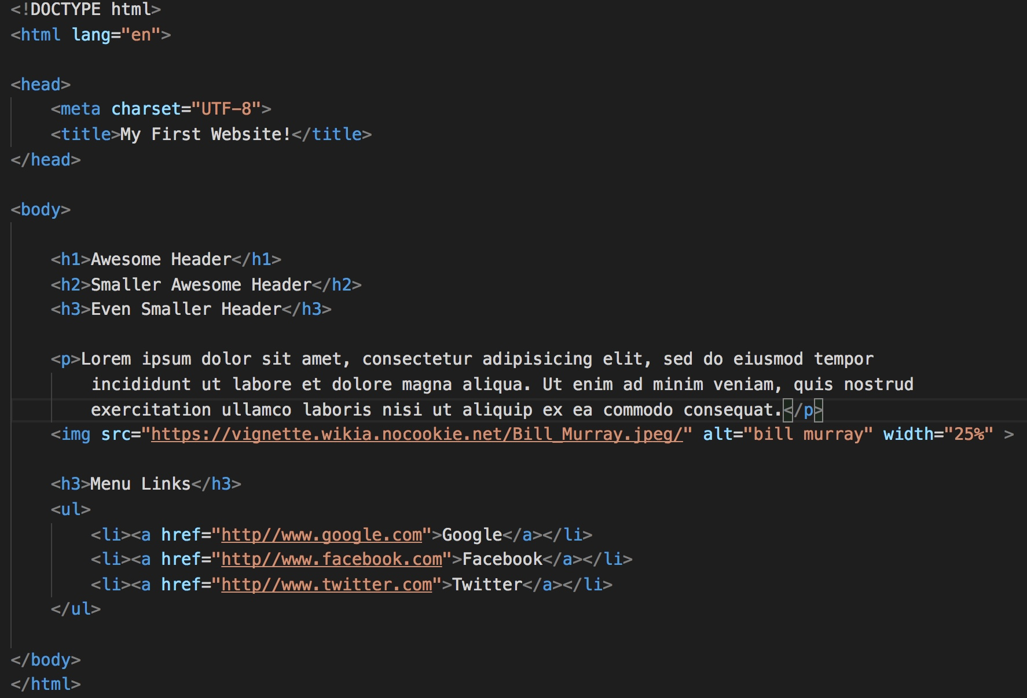
Basic HTML Page

Slide 66

Basic HTML Page - Result

Slide 67
Basic HTML Page - Result
Hella Boring…

Slide 68
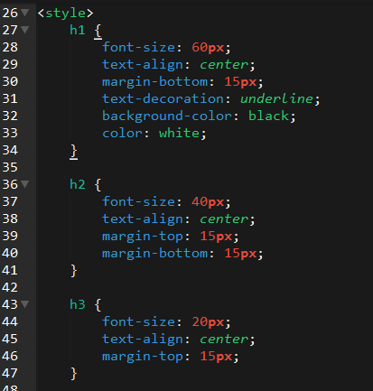
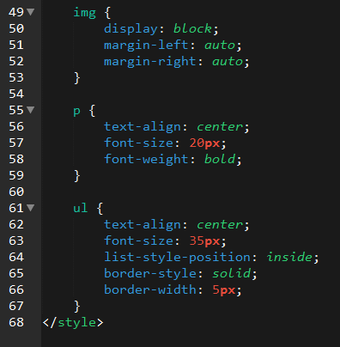
Enter CSS

Slide 69

Enter CSS - Result

Slide 70

CSS Syntax
CSS works by hooking onto selectors added into HTML using classes and identifiers.
Once hooked, we apply styles to those HTML elements using CSS.

Slide 71
CSS Example
In the below example the “Header” would be turned blue and MUCH larger because of the CSS.
We can incorporate an element’s class or ID to apply a CSS style to a particular part of the document.
Just remember to include the necessary symbol before the CSS: “.” for class, “#” for ID.
Example (HTML):
<p class=“bigBlue”>Header</p>
Example (CSS):
.bigBlue
{
font-size: 100px;
color: blue;
}

Slide 72
Key CSS Attributes
Font / Color:
color: Sets color of text.
font-size: Sets size of the font.
font-style: Sets italics.
font-weight: Sets bold.
Alignment / Spacing:
padding (top/right/bottom/left): Adds space between element and its own border.
margin (top/right/bottom/left): Adds space between element and surrounding elements.
float: Forces elements to the sides, centers, or tops.
Background:
background-color: sets background color.
background-image: sets background image.

Slide 73
Powerful Duo
Believe it or not, HTML / CSS is all you need
to develop a vivid, full-blown website.

Slide 74
INSTRUCTOR DEMO
Instructor: Demo
(quickexample_internalcss.html | 2-BasicCSS)

Slide 75
> YOUR TURN!
Activity: 3-HTML_CSS_Layout | Suggested Time: 20 min
Assignment
In this activity, you’ll upgrade your previous HTML bio-page using CSS style rules. Once you’re done, commit and push up your changes to GitHub.
We’ll send you additional instructions via Slack.

Slide 76
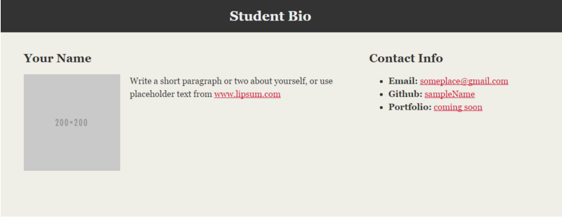
> YOUR TURN!

Slide 77
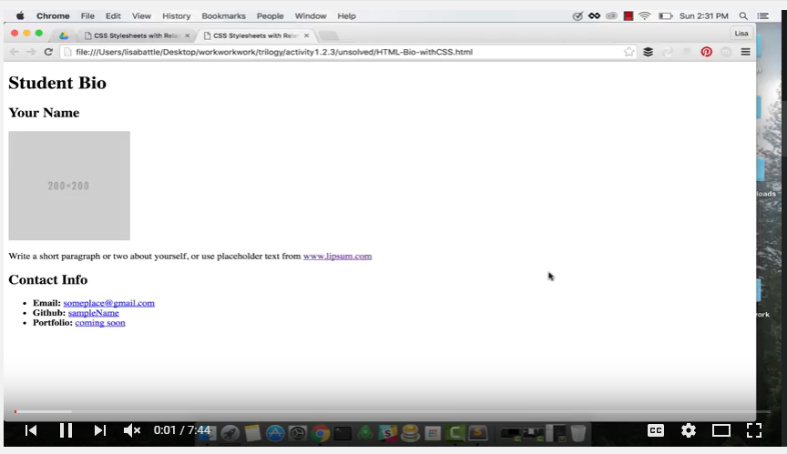
Video Walkthrough!!
https://www.youtube.com/watch?v=kMBinXTCrXI&list=PLgJ8UgkiorCnMLsUevoQRxH8t9bt7ne14&index=2

Slide 78

Still a Bit Confused?
Remember! We’ve got video guides for key activities like that last one.
If you feel like you are EVER falling behind, use those online walkthroughs to help catch back up. They are made to be easy to understand.
Still having trouble? Shoot your instructor or one of your TAs a message!
We are here to help you out in whatever way we can!

Slide 79
Homework #1 - Assignment
Also, at this point everyone should have access to the class homework repository. https://gw.bootcampcontent.com/GW-Coding-Boot-Camp/GWAR201810FSF3/tree/master
Homework Assignment #1 is due next week
Next Saturday (10/27/2018)

Slide 80
Recap + Questions

